Slide 1
HIV prevention in SRH services - challenges and opportunities
Amsterdam, 26 July 2018
Petrus Steyn, Scientist, RHR/HRX

Slide 2
Outline
Background
Linkages and integration
Opportunities and challenges
Conclusions

Slide 3
Background – SRHR and HIV intimately linked
HIV is primarily sexually transmitted or associated with pregnancy, birth and breastfeeding.
Sexually transmitted infections (STIs) such as gonorrhoea, herpes and syphilis can increase the risk of HIV acquisition and transmission two- or three-fold.
People living with HIV have specific SRHR needs, including but not limited to the prevention of mother-to-child transmission of HIV which requires an integrated service delivery response.
Share common determinants
economic inequality, limited access to appropriate information, gender inequality, harmful cultural norms and social marginalisation of the most vulnerable populations.

Slide 4
Consensus on the need for SRHR & HIV linkages
The Sustainable Development Goal, SDG 3 — to ensure healthy lives and promote well-being for all at all age
UN Global Strategy for Women’s Children and Adolescent Health (GSWACH) - focus on a comprehensive sexual and reproductive health and rights (SRHR) that includes HIV.
WHO Reproductive Health Strategy (2004) – includes HIV prevention and care as a core component of SRH
Global health sector strategy on HIV, STIs and Hepatitis (2016-2023) – combines targets under Universal Health care

Slide 5
Background
Numerous international statements, strategies and commitments to supporting SRHR and HIV linkages, including
Alma Ata in 1978,
International Conference on Population and Development in 1994
Glion Call to Action on Family Planning and HIV/AIDS in Women and Children (May 2004),
Maputo Plan of Action (2006),
UNGASS Declaration on HIV and AIDS (2011),
Political Declaration on HIV and AIDS (2016).

Slide 7
Linkages and Integration
Linkages refer to bi-directional synergies in policy, systems and services between SRHR and HIV of which service integration is a subset.
Service integration refers to the management and delivery of health services so that clients receive SRH and HIV services according to their needs over time and across different levels of the health system
Experience challenges in service integration and therefore important to address the broader linkages

Slide 8
Opportunities and challenges

Slide 9
An enabling environment for a linked SRHR and HIV response
Structural determinants of gender inequality, stigma and discrimination and a restrictive legal environment need to be addressed.
It also requires linkages between national HIV and SRHR policies, strategies, guidelines and operational plans, and funding.

Slide 10
Health systems that support SRHR and HIV integration
Weak health systems are responsible for many of the gaps that impede the full enjoyment of the right to health, including SRHR and HIV.
More comprehensive service delivery.
Health systems strengthening approach
focus on coordination mechanisms for SRHR and HIV joint planning, management, financing and administration of linked policy and integrated services; human resources and capacity building; procurement and supply chain management; and health information systems.

Slide 11
Integrated services to increase access to and utilisation of SRHR and HIV services
Enables clients to receive as many quality services as possible at the same time and in the same place, especially at the primary healthcare level.
It can reduce missed opportunities for accessing health services – particularly among people living with HIV and key populations.

Slide 12
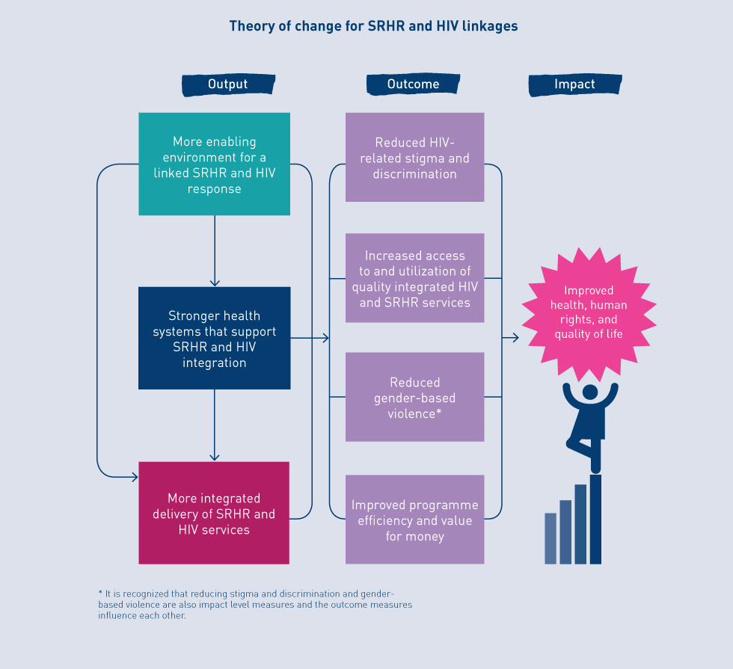
Advantages
SRHR and HIV Linkages are bi-directional, with HIV services integrated into existing SRHR services and vice versa with linked responses favourably impacting on both SRHR and HIV outcomes.
When SRHR and HIV-related policies, programmes and services are linked, this has the potential to lead to a number of important public health, socio-economic, and individual benefits such as:
Notes:
WHO, UNFPA, IPPF, UNAIDS (2005) Sexual and reproductive health and HIV/AIDS: a framework for priority linkages. London: IPPF http://srhhivlinkages.org/wp-content/uploads/2013/04/frameworkforprioritylinkages_2005_en.pdf Accessed 8 February 2016; Kennedy, C. E., A. B. Spaulding, D. B. Brickley, L. Almers, J. Mirjahangir, L. Packel, G. E. Kennedy, M. Mbizvo, L. Collins, K. Osborne (2010) “Linking sexual and reproductive health and HIV interventions: a systematic review.” Journal of the International AIDS Society 13:26
Church, K., W. Zhou, G. Ploubidis, I. Birdthistle, J. Kivunaga, I. Askew, C. Warren, S. Mayhew for the INTEGRA Research Team (2013a) “Impact of integration on HIV testing outcomes in FP and PNC cohorts in Kenya” Presentation at Integra Dissemination Meeting, London, July 2013 http://www.integrainitiative.org/blog/wp-content/uploads/2013/09/HIV-testing.pdf Accessed 8 February 2016
Church, K., A. Wringe, P. Fakudze, J. Kikuvi, Z. Nhlabatsi, R. Masuku, S. Mayhew, Integra Initiative (2014) “Reliance on condoms for contraceptive protection among HIV care and treatment clients: a mixed methods study on contraceptive choice and motivation within a generalised epidemic” Sex Transm Infect 10.1136; Mutemwa R., Mayhew S.H., Warren CE, Kimani J., Church K, Integra Initiative, Dualo Lao. (forthcoming) Integrating HIV and reproductive health services to increase consistent condom-use for HIV prevention: a multicentre, non-randomized trial. Lancet Infectious Diseases - Submitted
Mutemwa R., Mayhew S.H., Warren C.E., Abuya T., Ndwiga C., Kivunaga J., Integra Initiative (forthcoming) Does service integration improve technical quality of care in low resource settings? An evaluation of a model integrating HIV care into family planning services in Kenya.
Obure C. D., S. Sweeney, V. Darsamo, C. Michaels-Igbokwe, L. Guinness, F. Terris-Presthold, E. Muketo, Z. Nhlabatsi, Integra Initiative, C. E. Warren, S. Mayhew, C. Watts, A. Vassell. (2015) “The Costs of Delivering Integrated HIV and Sexual Reproductive Health Services in Limited Resource Settings.” PLOS One 2015 10(5); Integra Initiative (2015) Cost and technical efficiency of integrated HIV and SRH services in Kenya and Swaziland. Steps to Integration Issue 4. London: IPPF http://www.integrainitiative.org/wp/wp-content/uploads/2015/09/Integra-Steps04-Costs.pdf Accessed 8 February 2016
Church, K., A. Wringe, P. Fakudze, J. Kikuvi, D. Simelane, S. Mayhew and The Integra Initiative (2013b) “Are integrated HIV services less stigmatizing than stand-alone models of care? A comparative case study from Swaziland” Journal of the International AIDS Society 16:17981; Colombini, M., R. Mutemwa, J. Kivunaga, L. Stackpool-Moore, S. Mayhew and on behalf of the Integra Initiative (2014) “Experiences of stigma among women living with HIV attending sexual and reproductive health services in Kenya: a qualitative study” BMC Health Services Research 14:412
Kennedy, C. E., A. B. Spaulding, D. B. Brickley, L. Almers, J. Mirjahangir, L. Packel, G. E. Kennedy, M. Mbizvo, L. Collins, K. Osborne (2010) “Linking sexual and reproductive health and HIV interventions: a systematic review.” Journal of the International AIDS Society 13:26

Slide 13
http//toolkit.srhhivlinkages.org

Slide 14
Conclusion
A narrow focus on service integration without looking at broader linkages may not succeed
SRHR and HIV Linkages favourably impact both SRHR and HIV outcomes
Good resources available to support linkages of SRH and HIV
Rolling out of oral PrEP provides us with a very good opportunity to strengthen linkages

Slide 15
WHO Dec 2015 recommendation
Oral PrEP containing TDF should be offered as an additional prevention choice for people at substantial risk of HIV infection as part of combination HIV prevention approaches
http://apps.who.int/iris/bitstream/10665/186275/1/9789241509565_eng.pdf?ua=1

Slide 16
Follow us on Twitter @HRPresearch
Visit our website who.int/reproductivehealth

